Slide 1
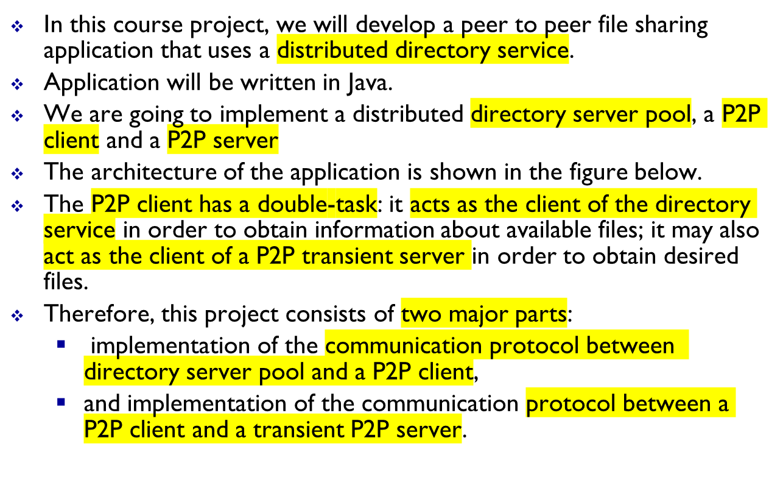
CPS 706 course project :
A Peer to Peer shared photo album with distributed directory
n
1-<number>

Slide 2

bob
Directory server #1
2 Inform and update
alice
Dir. server #2
1 Init
claire
Dir. server #4
3 query for content
5 exit
don
Directory server #3
4 File transfer
2 query for content
emily
1-<number>

Slide 3
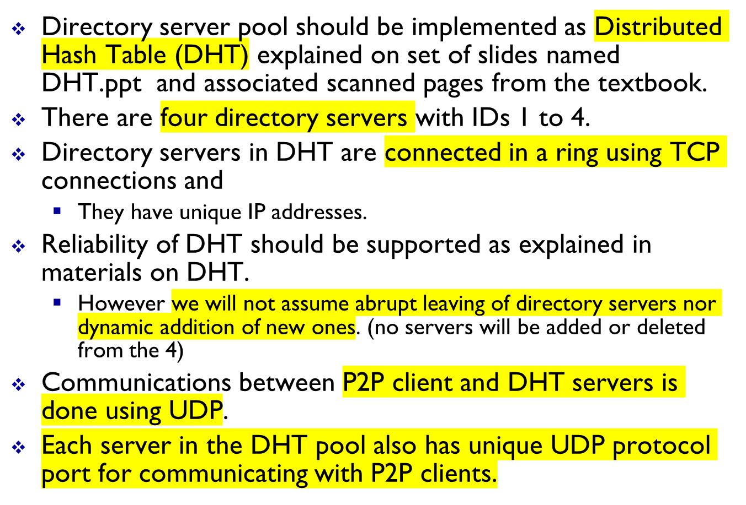
Implementation of Directory server pool as DHT
1-<number>

Slide 4
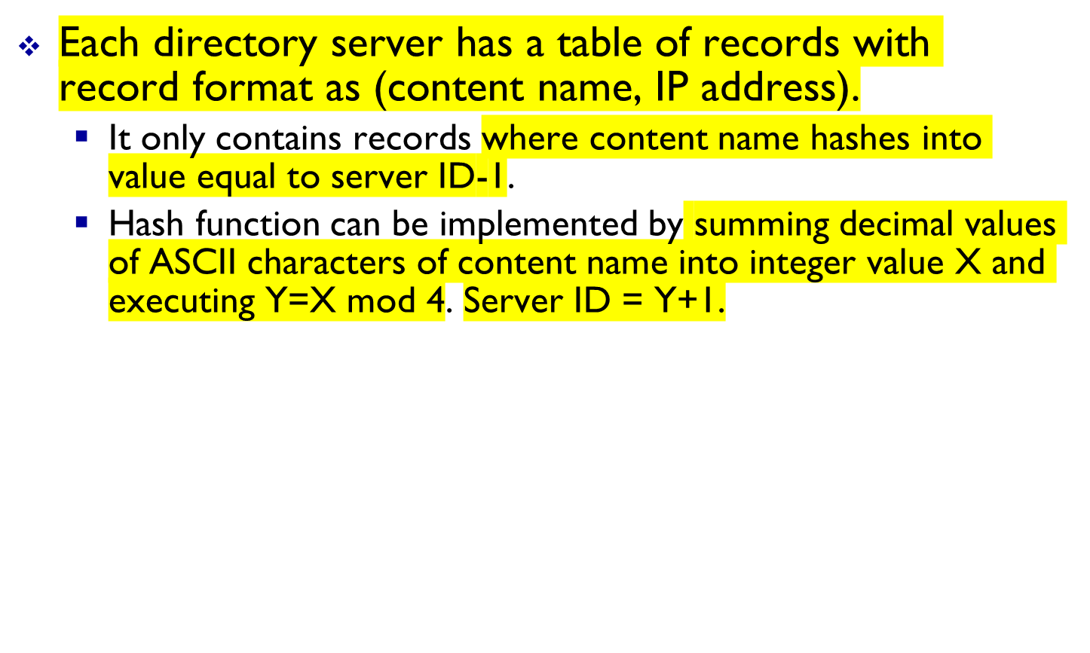
Implementation of Directory server pool
1-<number>

Slide 5

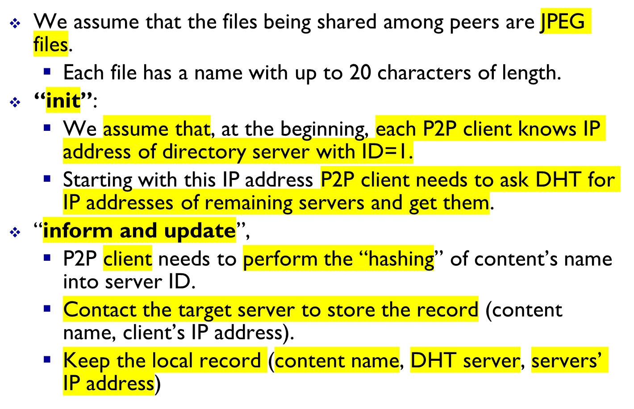
1-<number>

Slide 6
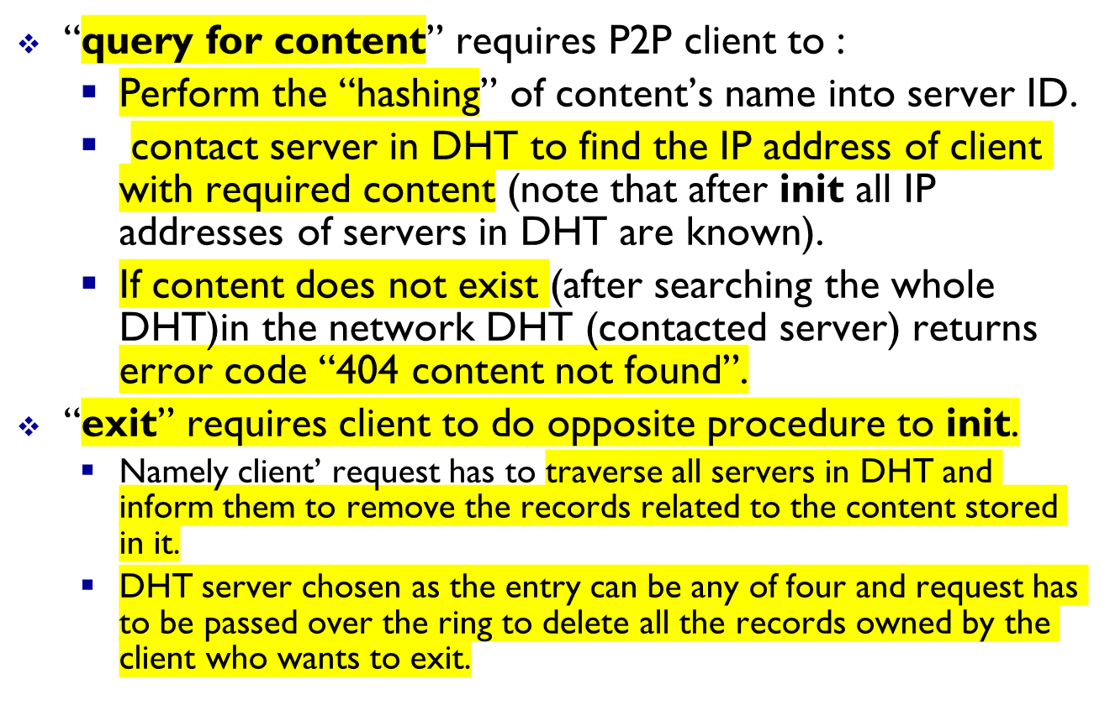
P2P client’s interactions with Directory server pool
1-<number>

Slide 7
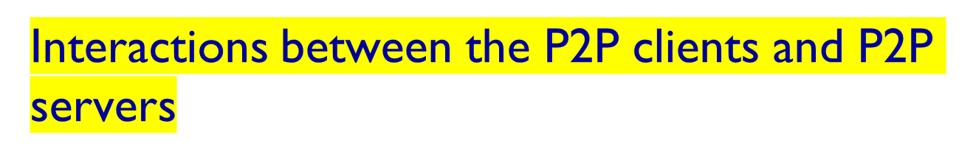
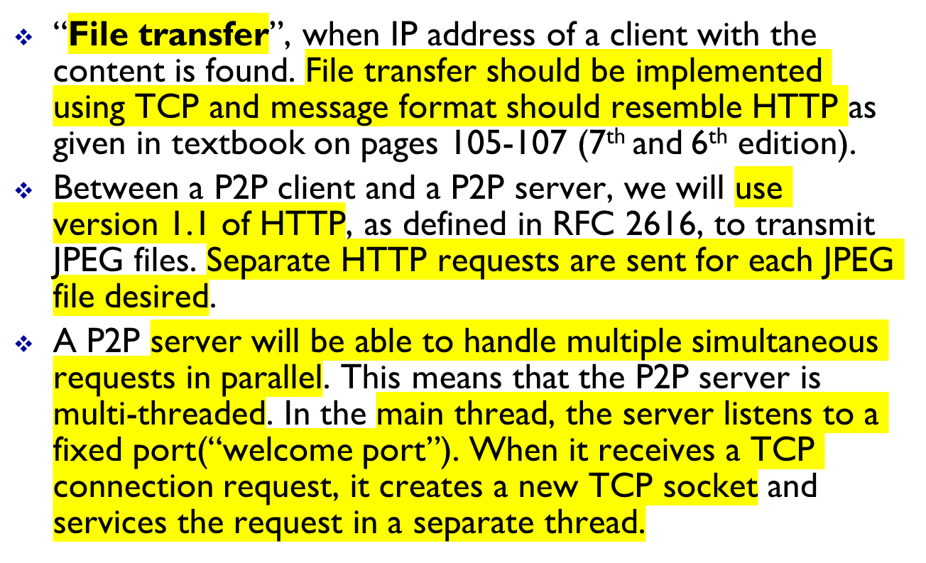
1-<number>

Slide 8
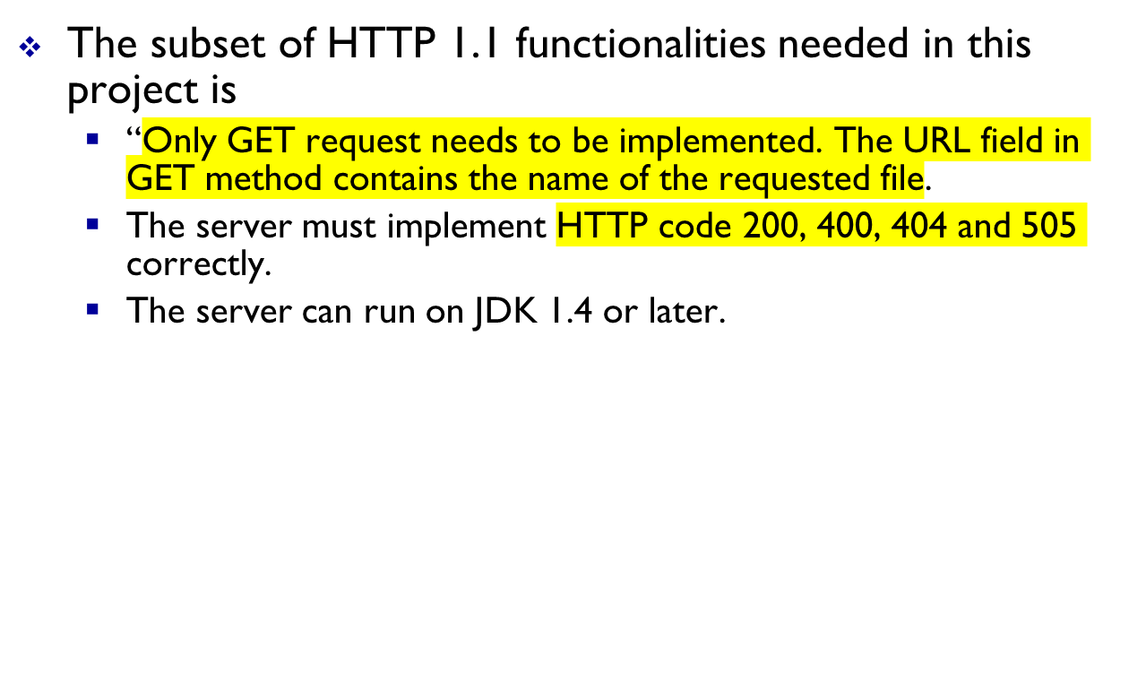
Interactions between the P2P clients and P2P servers
1-<number>

Slide 9
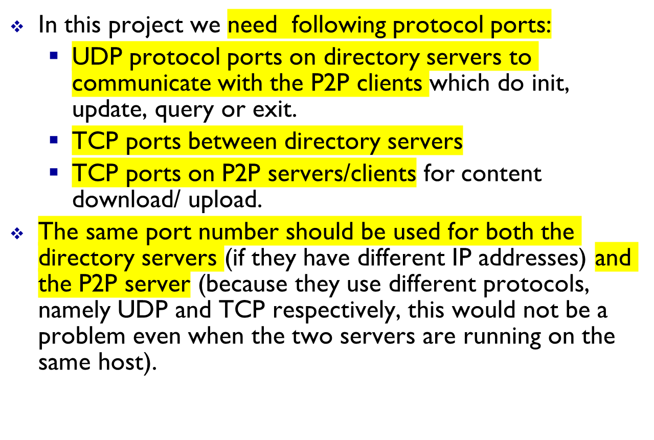
Port number assignment
1-<number>

Slide 10
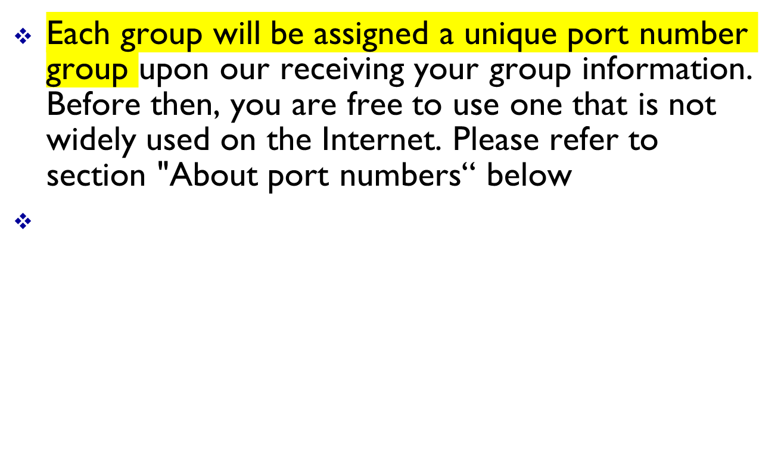
Port number assignment
1-<number>

Slide 11
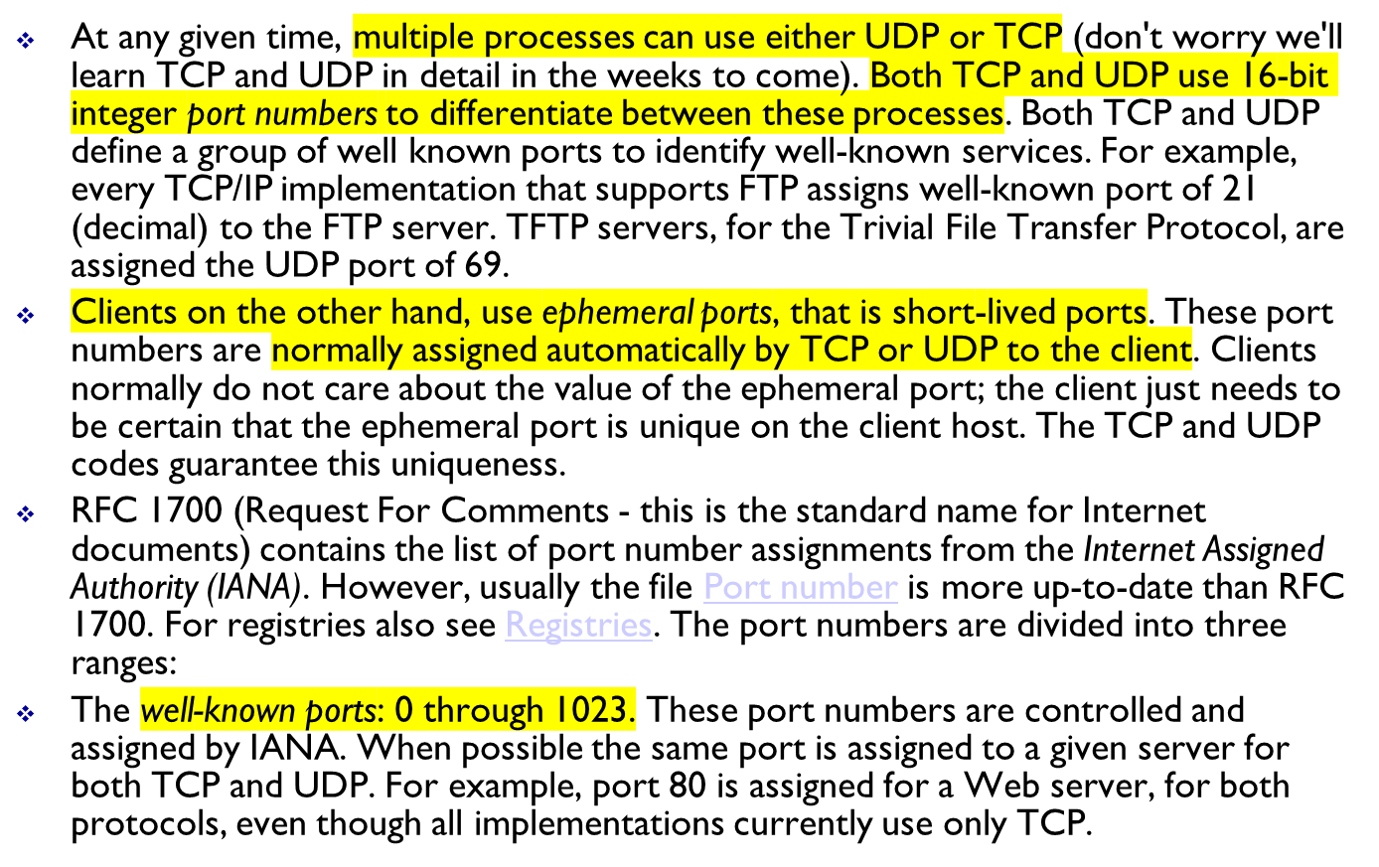
About port numbers
1-<number>

Slide 12
About port numbers
The registered ports: 1024 through 49151. These are not controlled by the IANA, but the IANA registers and lists the uses of these ports as a convenience to the community. When possible the same port is assigned to a given service for both TCP and UDP. For example, ports 6000 through 6063 are assigned for an X Window server for both protocols, even though all implementations currently use only TCP. The upper limit of 49151 for these ports is new, as RFC 1700 lists the upper range as 65535 (FYI only).
The dynamic or private ports, 49152 through 65535. The IANA says nothing about these ports. These are what we call ephemeral ports.
Some interesting points: Unix systems have the concept of a reserved port, which is any port less than 1024. These ports can be assigned to a socket by a super user process. All the IANA well-known ports are reserved ports; hence the server allocating this port (such as the FTP server) must have super user privileges when it starts.
Introduction
1-<number>

Slide 13
About port numbers
Historically, Berkeley-derived implementations have allocated ephemeral ports in the range 1024-5000. This was fine in the early 1980s, when server hosts were not capable of handling more than 3977 clients at any given time. Therefore some systems allocate ephemeral ports differently to provide more ephemeral ports. For example, Solaris allocates ephemeral ports in the range 32768-65535.
There are few clients (not servers) that require a reserved port as part of the client-server authentication: the rlogin and rsh clients are the common examples. These clients call the library function resvport to create a TCP socket and assign an unused port in the range 513-1023 to the socket. This function normally tries to bind port 1023 and if it fails, tries to bind 1022, and so on, until it either succeeds or fails on port 513.
Note that during program development, you as the client-server application programmer must be responsible to avoid conflicts in choosing protocol port for your server application!
Introduction
1-<number>

